Slide 1


Computer
Fundamentals
Dr. Safdar Nawaz Khan
Marwat
DCSE, UET
Peshawar
Lecture 7
safdar@uetpeshawar.edu.pk

Slide 2
Number System Conversion
➢ Direct conversions possible for
❑ Binary to octal and vice versa
❑ Binary to hexadecimal and vice versa
❑ Decimal to octal and vice versa
❑ Decimal to hexadecimal and vice
versa
➢ Numbers
with
other
bases
safdar@uetpeshawar.edu.pk
2

Slide 3
Decimal – Octal
Conversion
➢ Convert
(75)10
to
octal
8
75
remainder
8
9
3
8
1
1
0
1
(113)₈
safdar@uetpeshawar.edu.pk
3

Slide 4
Decimal – Octal Conversion
(cont.)
➢ Convert
113
from octal to decimal
(113)8
=
1x8²
+ 1x8¹
+ 3x8⁰
=
64
+
8
+
3
=
(75)10
safdar@uetpeshawar.edu.pk
4

Slide 5
Decimal – Hexadecimal
Conversion
➢ Convert
(75)10
to
hexadecimal
16
75
remainder
16
4
B
0
4
(4B)₁₆
safdar@uetpeshawar.edu.pk
5

Slide 6
Decimal – Hexadecimal Conversion
(cont.)
➢ Convert
4B
from hexadecimal to
decimal
(4B)16
=
4x16¹ +
11x16⁰
=
64
+
11
=
(75)10
safdar@uetpeshawar.edu.pk
6

Slide 7
Numbers with Other Bases
➢ Numbering
❑ Base 3, 4,
➢ Conversion
systems possible with other bases
5 etc.
to
decimal
or
any
other
base
possible
safdar@uetpeshawar.edu.pk
7

Slide 8
Base-3 System
➢ Base
3
numbers expressed in positional notation
The right-most is the
least significant
digit
1202 = 1x3³ + 2x3² + 0x3¹
+ 2x3⁰
The
left-most is the
most
significant
digit
safdar@uetpeshawar.edu.pk
8

Slide 9
Base-3
System (cont.)
➢ Constituents
of a
decimal number
1
1202
= 1x3³ + 2x3² + 0x3¹
+ 2x3⁰
1’s
multiplier
safdar@uetpeshawar.edu.pk
9

Slide 10
Base-3
System (cont.)
➢ Constituents
of a
decimal number
3
1202
= 1x3³ + 2x3²
+ 0x3¹
+ 2x3⁰
3’s
multiplier
safdar@uetpeshawar.edu.pk
10

Slide 11
Base-3
System (cont.)
➢ Constituents
of a
decimal number
9
1202 = 1x3³ + 2x3²
+ 0x3¹
+ 2x3⁰
9’s
multiplier
safdar@uetpeshawar.edu.pk
11

Slide 12
Base-3
System (cont.)
➢ Constituents
of a
decimal number
27
1202 = 1x3³
+ 2x3²
+ 0x3¹
+ 2x3⁰
27’s
multiplier
safdar@uetpeshawar.edu.pk
12

Slide 13
Base 3 – Decimal Conversion
➢ Convert
75
from
decimal
to
base
3
3
75
remainder
3
25
0
3
8
1
3
2
2
0
2
2210
safdar@uetpeshawar.edu.pk
13

Slide 14
Base 3 – Decimal Conversion
(cont.)
➢ Convert
2210 from base 3 to decimal
2210
=
2x3³ +
2x3²
+
1x3¹
+ 0x3⁰
=
54
+
18
+
3
+
0
=
75
safdar@uetpeshawar.edu.pk
14

Slide 15
Logical Operations Revisited
➢ Truth table for
three or
approach
more
input
variables
❑ Follow
stepwise
x
y
z
x ⊕ y
(x ⊕ y ). z
0
0
0
0
0
0
0
1
0
0
0
1
0
1
0
0
1
1
1
1
1
0
0
1
0
1
0
1
1
1
1
1
0
0
0
1
1
1
0
0
safdar@uetpeshawar.edu.pk
15

Slide 16
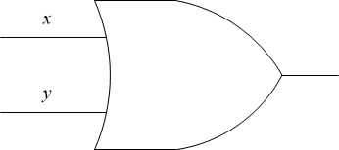

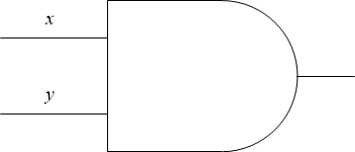
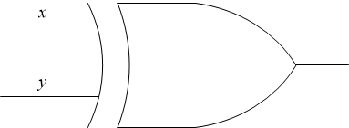
Diagrammatic Representation
➢ Graphical
depiction of
boolean
expression
x
x
+
y
x
.
y
x ⊕ y
safdar@uetpeshawar.edu.pk
16

Slide 17
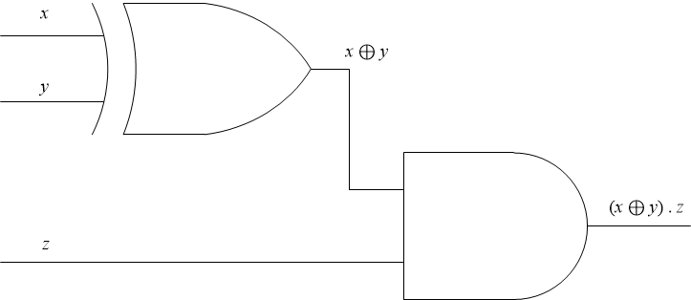
Diagrammatic Representation (cont.)
➢ Draw
diagram
for
representation
of
boolean
expression
(x
⊕ y ).
z
safdar@uetpeshawar.edu.pk
17

Slide 18
Exercise
➢ Derive
truth
table
for
(x
+ y ) ⊕
z
x
y
z
0
0
0
0
0
1
0
1
0
0
1
1
1
0
0
1
0
1
1
1
0
1
1
1
safdar@uetpeshawar.edu.pk
18

Slide 19
Exercise (cont.)
➢ Draw
diagram
of
boolean expression
(x
+ y ) ⊕
z
safdar@uetpeshawar.edu.pk
19

Slide 20
Exercise (cont.)
➢ Derive
truth
table
for
(x + y) ⊕ z
x
y
z
0
0
0
0
0
1
0
1
0
0
1
1
1
0
0
1
0
1
1
1
0
1
1
1
safdar@uetpeshawar.edu.pk
20

Slide 21
Exercise (cont.)
➢ Draw
diagram
for representation of
boolean
expression
(x
+ y)⊕
z
safdar@uetpeshawar.edu.pk
21

Slide 22
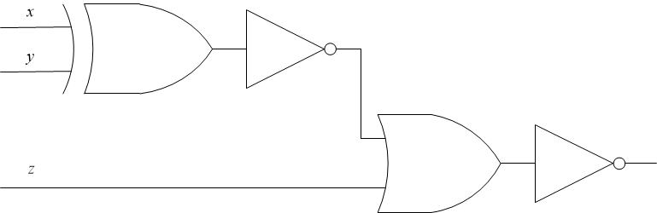
Exercise (cont.)
➢ Determine truth table for the following logic diagram
➢ Write
the
boolean
expression
for
this
diagram
safdar@uetpeshawar.edu.pk
22

